Slide 1
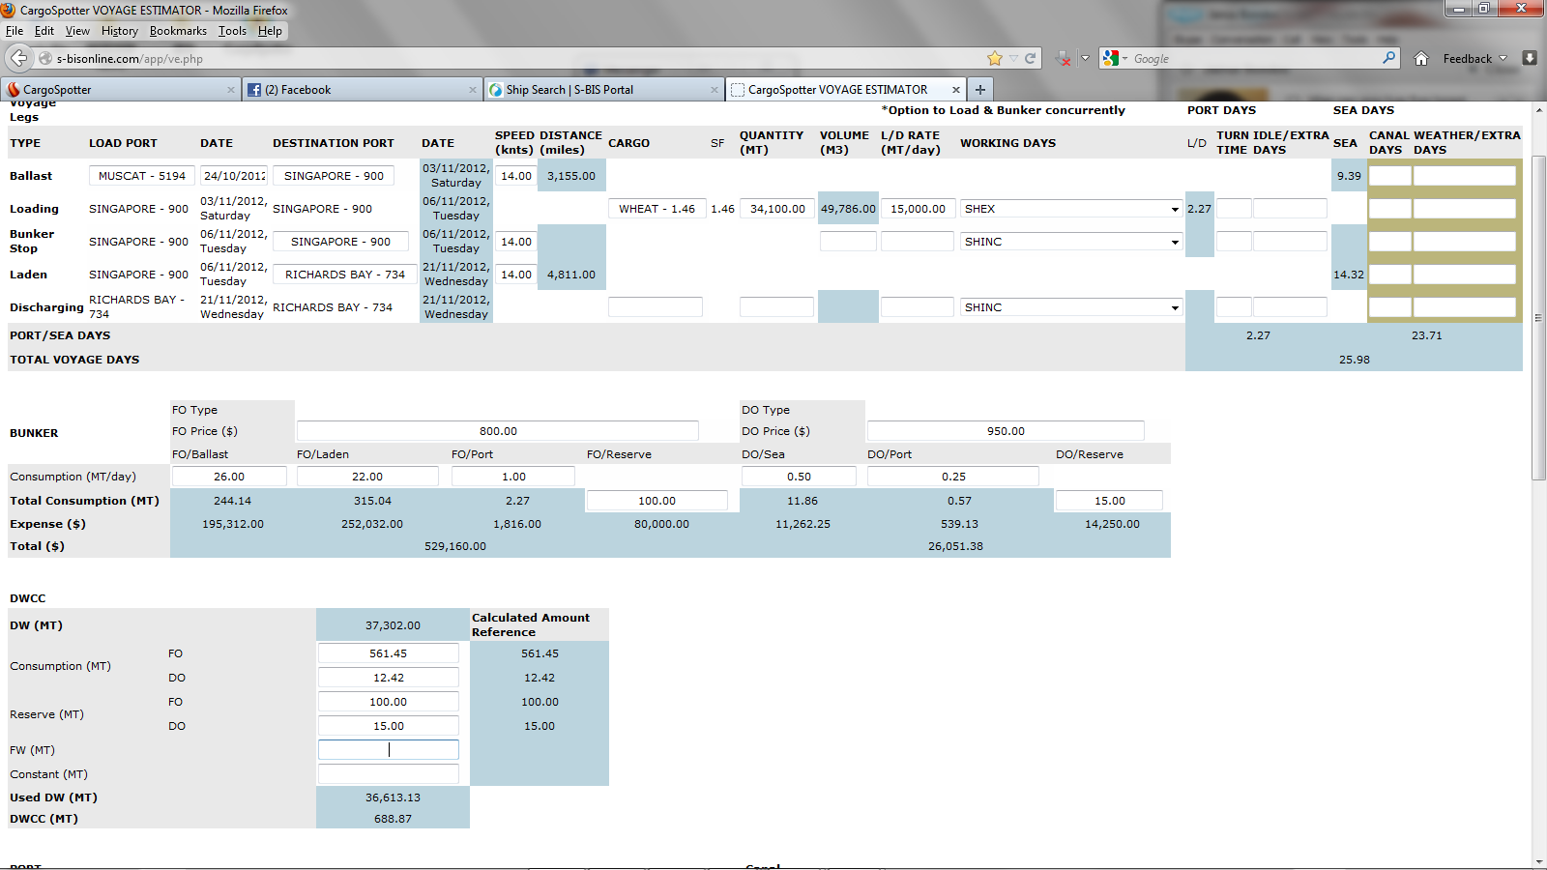
Used is 688.87 DWCC is the DW - Used
Fields the wrong way around

